Slide 1



Murder & The

Slide 2

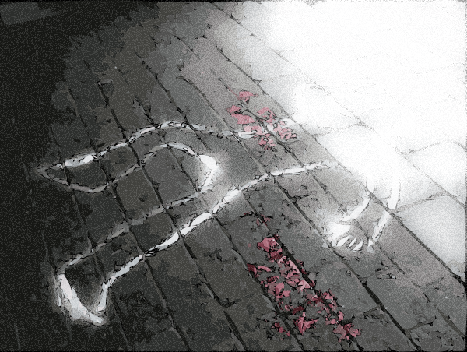
MURDER
is not where evildoers are punished by death
  “You shall not murder” (Ex. 20:13)
  “He who strikes a man
  so that he dies shall surely be put to death”
  (Ex. 21:12)
MURDER
NOT
MURDER

Slide 3
MURDER
is not where evildoers are punished by death
  "Whoever sheds man’s blood, By man his blood shall be shed; For in the image of God He made man” (Gen. 9:6)
MURDER
1
2
NOT
MURDER
3
REASON

Slide 4

Murder (Ex. 21:12-14)
Kidnapping (Ex. 21:16)
Striking/cursing parents (Ex. 21:15, 17)
The incorrigible (Deut. 17:8-13)
Sacrificing to false gods
(Ex. 22:20)
Sabbath breaking (Ex. 35:2)
Blasphemy (Lev. 24:10-16)

Slide 5
Enticement to idolatry (Deut. 13:1ff)
Sorcery (Ex. 22:18)
Adultery (Deut. 22:22)
Bestiality (Ex. 22:19)
Incest (Lev. 18:6ff)
Homosexuality (Lev. 20:13)
Premarital relations (Lev. 21:9; Deut. 22:20, 21)
Rape (Deut. 22:25-27)

Slide 6

MURDER
“…you profane Me among My people for handfuls of barley and for pieces of bread, killing people who should not die, and keeping people alive who should not live…” (Ezek. 13:19)

Slide 7
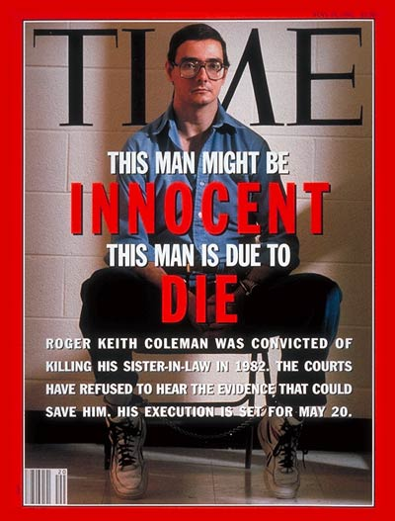
MURDER
Roger Keith Coleman became the face used to oppose the death penalty
From oblivion to national recognition
Was found guilty of rape and murder of his 19 year old sister-in-law in a crime that happened 3/10/81
Was baptized by a church of Christ preacher
Perpetuated his innocence through national media until till the day of his execution
Further confirmed guilty by modern DNA tests

Slide 8
MURDER
“…you profane Me among My people for handfuls of barley and for pieces of bread, killing people who should not die, and keeping people alive who should not live…” (Ezek. 13:19)
Matthew 27:16-24

Slide 9
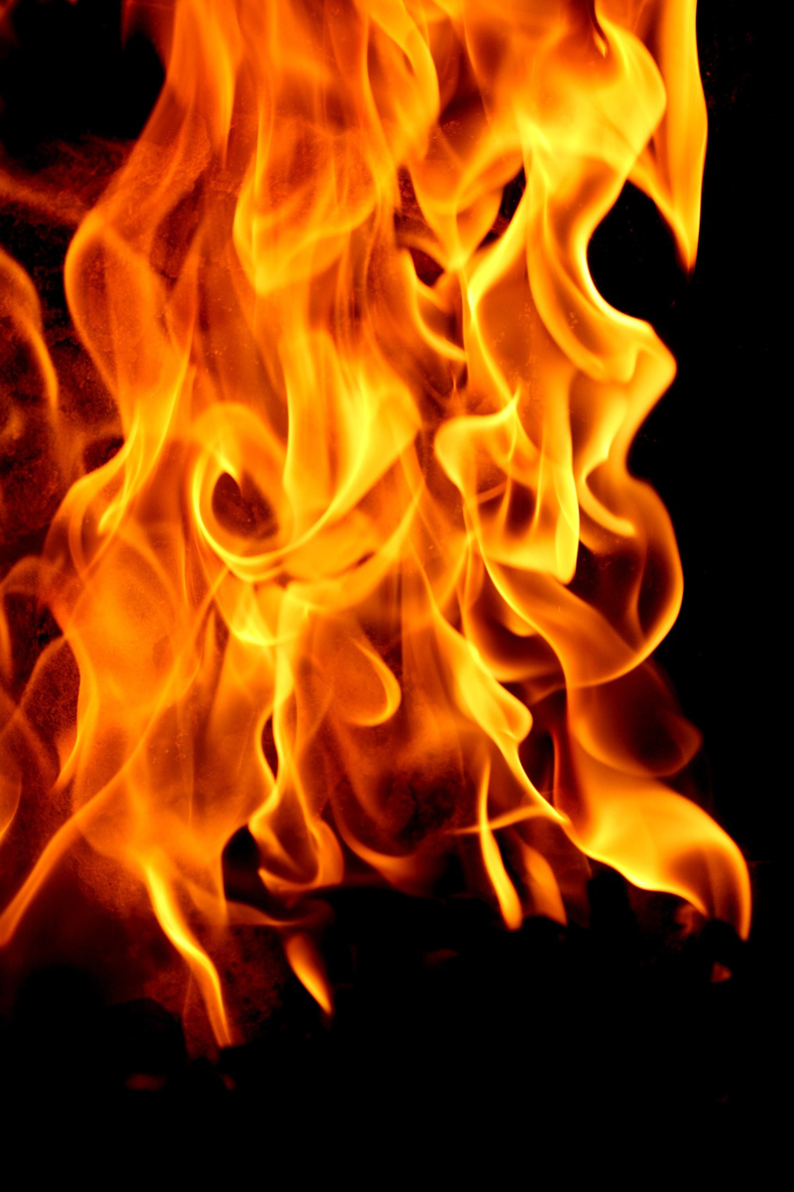

Acts 3:14, “But you denied the Holy One and the Just, and asked for a murderer to be granted to you”

